Slide 1
Network Security
Assignment 1
Manavjeet Singh 2018295
Rhythm Gupta 2018082

Slide 2
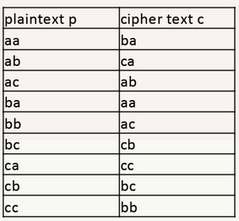
Pairwise
monoalphabetic Substitution Cipher
Replace a pair of alphabets with another pair of alphabets.
For symbol set {A,B,C}, we have 9! Keys
Concatenated with plaintext its MD5 hash to verify the text while bruteforce.
For example : E(aa, k) = ba || MD5(aa)
Try all keys on given ciphertexts for cryptanalysis
Image Source: IIITD CSE350 Monsoon 2020 Slides

Slide 3
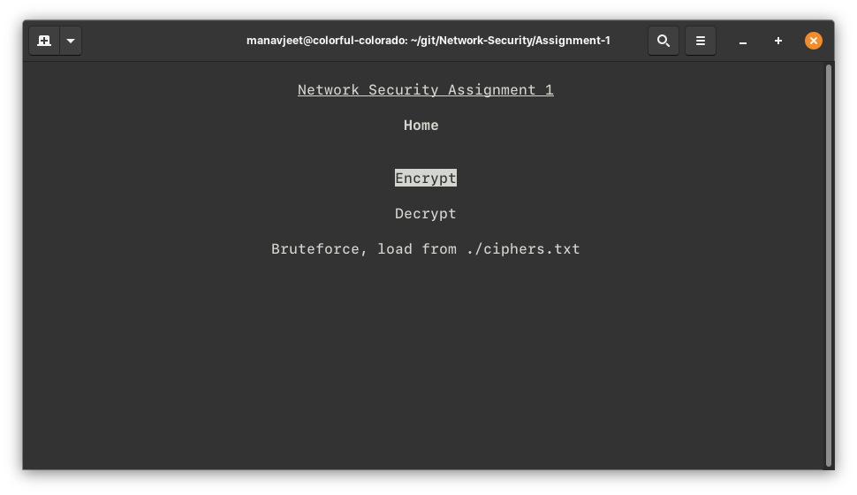
Running
Make sure you have following libraries installed in python3
Curses
Hashlib
Itertools
Pickle
Open a terminal in the assignment directory.
Run ‘python3 main.py’

Slide 4
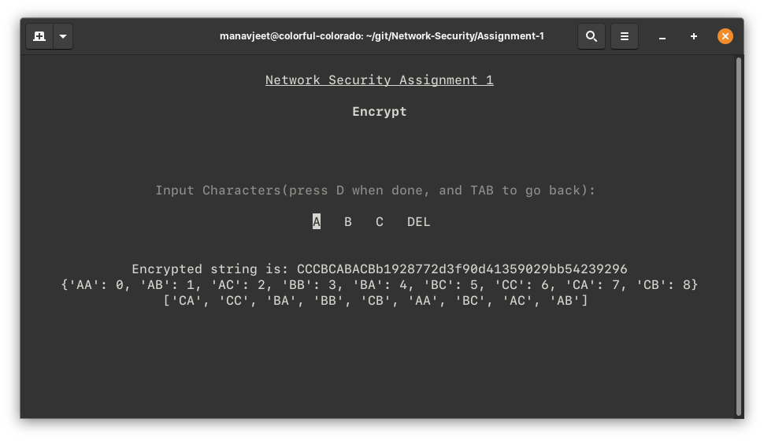
Encrypting
Select the encrypt button and press enter
Enter the plain text using onscreen buttons
Press ‘D’ to see results
Press ‘TAB’ to go to main menu

Slide 5
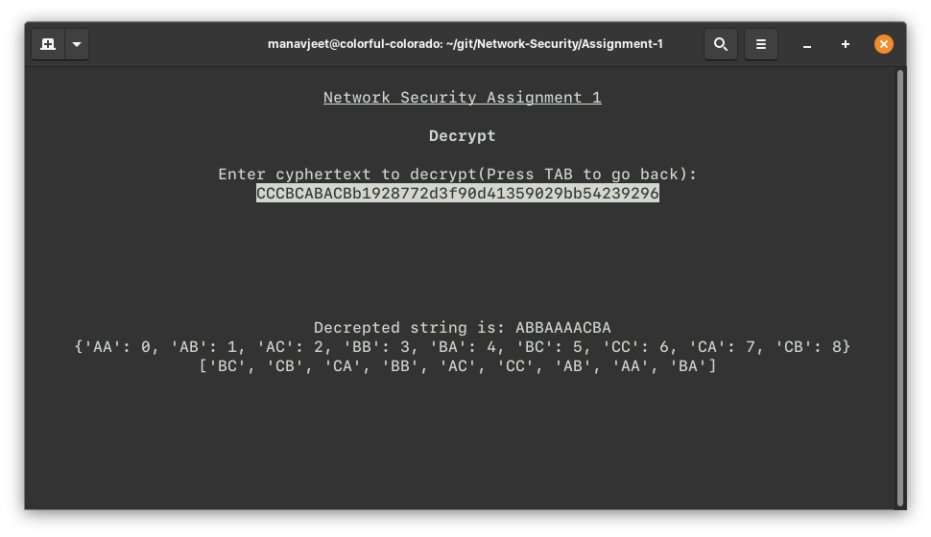
Decrypting
Select the decrypt button and press enter
Enter the cipher text from keyboard
Press ‘Enter’ to see results
Press ‘TAB’ to go to main menu

Slide 6
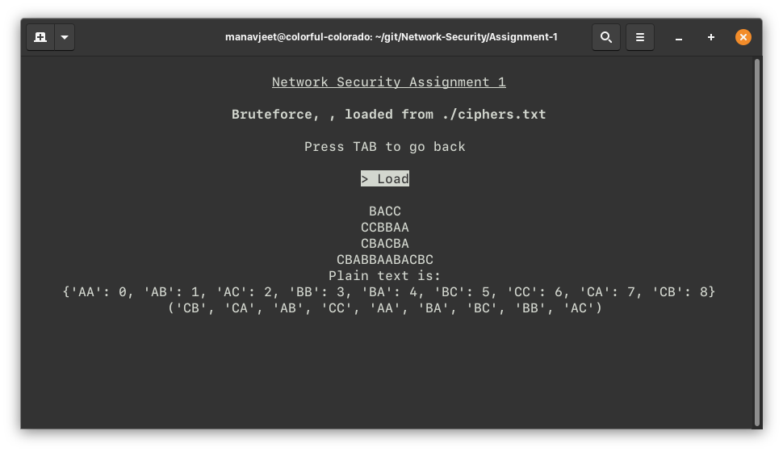
Bruteforce
Add four cipher texts in ciphers.txt in assignment directory
Select the Bruteforce button and press enter
Select Load and press enter
Results will be printed on the screen

